Slide 1
Are the neighbourhoods of New York similar to Toronto

Slide 2
Business problem
The cities New York and Toronto are very diverse and are the financial capitals of their respective countries.
One interesting idea would be to compare the neighborhoods of the two cities and determine how similar or dissimilar they are. Is New York City more like Toronto?
Can we identify how similar are the neighbourhoods of New York to the neighbourhoods of toronto?

Slide 3
Background and Importance
We are going to explore the neighbourhoods of the two cities using Foursquare API.
We are going to explore the top 100 venues around each neighbourhood in the cities using Foursquare API and build a metric for each neighbourhood based on the category type of each venue.
We are going to apply the k-means clustering algorithm for grouping the neighbourhoods to find out the similarity between the neighbourhoods of both the cities.
This problem would be helpful to the people who are having trouble in taking a decision of choosing a neighbourhood of the city to take residence or to have breakfast,lunch/dinner or to travel as some people choose to travel to cities which are different from the cities they have already visited while some people choose to travel to cities which are similar to the cities they have already visited.

Slide 4
Data understanding
As the neighbourhoods in New York are very large in number, I have chosen only the neighbourhoods in the borough Manhattan for representing New York.
We can collect the location data of the neighbourhoods of New York and Toronto and explore the top 100 venues around each neighbourhood using the Foursquare API.
Moreover, we are exploring the top 100 venues around each neighbourhood for both cities because we need some means of comparison between the neighbourhoods for grouping.
By using these venues for the neighbourhoods we can apply one hot encoding and build a metric of comparison based on the category types of each venue.

Slide 5
Data processing
Create a dataframe which shows the location coordinates of the neighbourhoods.
Get the top 100 venues around each neighbourhood location into a new dataframe for both cities
Perform one hot encoding on the dataframe obtained from the above step for each neighbourhood based on the category type for both cities into a new dataframe. It consists of all category types as the columns.
Perform the group by neighbourhood operation on the dataframe in Step 3 and perform the mean operation on each group which will give the mean occurrence/frequency of each category in the respective neighbourhood.Perform it for both cities.
Create a new dataframe which shows neighbourhood along with top 10 venues in the respective neighbourhood. Perform it for both cities.
Concatenate the two dataframes of two cities obtained from step 4. It simply combines the neighbourhoods of New York and Toronto. Each row shows a category metric of each neighbourhood based on which we perform k-means clustering.
Add a City column to the two dataframes obtained from Step 5. Concatenate the two dataframes of two cities obtained from step 5. It simply combines the neighbourhoods of new york and toronto. Each row shows the top 10 venues of the respective neighbourhood.

Slide 6
Methodology
The final dataframe has 79 rows and 380 columns. Rows represent neighbourhood and columns represent the different venue categories.
Out of the 79 neighbourhoods, 39 of them correspond to Toronto and the rest of them correspond to Manhattan(New York).
The metric which we are going to use for comparing different neighbourhoods is the venue category metric along the neighbourhood's row.
The machine learning algorithm which is best suitable for our situation is k-means clustering.
We are going to apply the k-means clustering using our final dataframe as the input data and group all the neighbourhoods.
What is the best value of k we need to use for the k-means clustering? We are going to decide it using elbow method.
By choosing the optimal value of k, we train the model and visualize all the neighbourhoods grouped based on cluster labels on the folium Map object.

Slide 7
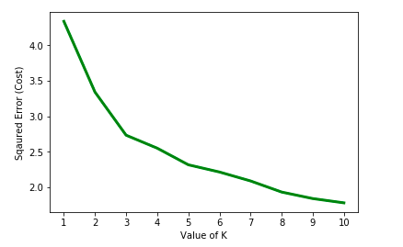
Elbow method for choosing the best k
Optimal k is 5

Slide 8
Cluster analysis
 | New York | Toronto | Total neighbourhoods
Cluster 1 | 35 | 14 | 49
Cluster 2 | 0 | 3 | 3
Cluster 3 | 0 | 1 | 1
Cluster 4 | 0 | 1 | 1
Cluster 5 | 5 | 20 | 25
Aggregate | 40 | 39 | 79

Slide 9
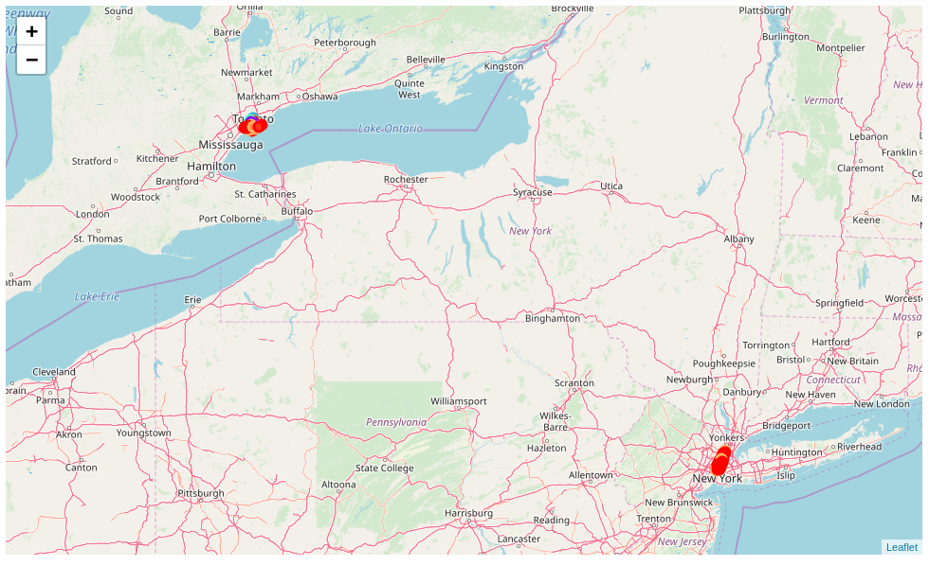
Neighbourhoods on a Map

Slide 10
Results
Cluster 1
Toronto
1.High Park,The Junction South
2.Davisville
3.Runnymede,Swansea
4.Chinatown,Grange Park,Kensington Market
5.Little Portugal,Trinity
6.Studio District
7.Harbord,University of Toronto
8.The Beaches West,India Bazaar
9.Dovercourt Village,Dufferin
10.CN Tower,Bathurst Quay,Island airport,
Harbourfront West,King and Spadina,
Railway Lands,South Niagara
11.Parkdale,Roncesvalles
12.Business Reply Mail Processing Centre 969 Eastern
13.The Danforth West,Riverdale
14.The Beaches
New York
1.Turtle Bay
2.Hudson Yards
3.Upper East Side
4.Flatiron
5.West Village
6.Manhattanville
7.Little Italy
8.East Harlem
9.Inwood
10.Greenwich Village
11.Sutton Place
12.Gramercy
13.Hamilton Heights
14.Central Harlem
15.Tudor City
16.Noho
17.Stuyvesant Town
18.Chelsea
19.Tribeca
20.Chinatown
21.Lower East Side
22.Midtown
23.Clinton
24.Upper West Side
25.Washington Heights
26.Carnegie Hill
27.Civic Center
28.Murray Hill
29.Lenox Hill
30.Lincoln Square
31.Yorkville
32.Midtown South
33.East Village
34.Manhattan Valley
35.Soho

Slide 11
Cluster 2
Toronto
1.Rosedale
2.Moore Park,Summerhill East
3.Forest Hill North,Forest Hill West
Cluster 3
Toronto
1.Lawrence Park
Cluster 4
Toronto
1.Roselawn

Slide 12
Cluster 5
Toronto:
1.Christie
2.Berczy Park
3.Queen's Park
4.Harbourfront East,Toronto Islands,Union Station
5.Deer Park,Forest Hill SE,Rathnelly,South Hill,Summerhill West
6.Adelaide,King,Richmond
7.Harbourfront
8.Commerce Court,Victoria Hotel
9.Church and Wellesley
10.Brockton,Exhibition Place,Parkdale Village
New York:
1.Financial District
2.Morningside Heights
3.Marble Hill
4.Roosevelt Island
5.Battery Park City
11.St. James Town
12.North Toronto West
13.Central Bay Street
14.The Annex,North Midtown,Yorkville
15.Davisville North
16.Cabbagetown,St. James Town
17.Design Exchange,Toronto Dominion Centre
18.First Canadian Place,Underground city
19.Ryerson,Garden District
20.Stn A PO Boxes 25 The Esplanade

Slide 13
Discussion
There are 14 neighbourhoods in Toronto which are similar to 35 neighbourhoods in Manhattan(New York) in cluster 1.
There are 20 neighbourhoods in Toronto which are similar to 5 neighbourhoods in Manhattan(New York) in cluster 5.
There is no similarity between the other 5 neighbourhoods of Toronto present in cluster 2,cluster 3,cluster 4 and the neighbourhoods of Manhattan(New York).
Hence, we can recommend the above observations we have made to the people who are looking for neighbourhoods of Toronto which are similar to New York or vice versa.

Slide 14
Conclusion
We can conclude that the below neighbourhoods of Toronto are similar to the below neighbourhoods of New York.
New York
1.Turtle Bay
2.Hudson Yards
3.Upper East Side
4.Flatiron
5.West Village
6.Manhattanville
7.Little Italy
8.East Harlem
9.Inwood
10.Greenwich Village
11.Sutton Place
12.Gramercy
13.Hamilton Heights
14.Central Harlem
15.Tudor City
16.Noho
17.Stuyvesant Town
18.Chelsea
19.Tribeca
20.Chinatown
21.Lower East Side
22.Midtown
23.Clinton
24.Upper West Side
25.Washington Heights
26.Carnegie Hill
27.Civic Center
28.Murray Hill
29.Lenox Hill
30.Lincoln Square
31.Yorkville
32.Midtown South
33.East Village
34.Manhattan Valley
35.Soho
Toronto
1.High Park,The Junction South
2.Davisville
3.Runnymede,Swansea
4.Chinatown,Grange Park,Kensington Market
5.Little Portugal,Trinity
6.Studio District
7.Harbord,University of Toronto
8.The Beaches West, India Bazaar
9.Dovercourt Village,Dufferin
10.CN Tower,Bathurst Quay,Island airport,
Harbourfront West,King and Spadina,
Railway Lands,South Niagara
11.Parkdale,Roncesvalles
12.Business Reply Mail Processing Centre 969 Eastern
13.The Danforth West,Riverdale
14.The Beaches

Slide 15
We can conclude that the below neighbourhoods of Toronto are similar to the below neighbourhoods of New York.
Toronto:
1.Christie
2.Berczy Park
3.Queen's Park
4.Harbourfront East,Toronto Islands,Union Station
5.Deer Park,Forest Hill SE,Rathnelly,South Hill,Summerhill West
6.Adelaide,King,Richmond
7.Harbourfront
8.Commerce Court,Victoria Hotel
9.Church and Wellesley
10.Brockton,Exhibition Place,Parkdale Village
New York:
1.Financial District
2.Morningside Heights
3.Marble Hill
4.Roosevelt Island
5.Battery Park City
11.St. James Town
12.North Toronto West
13.Central Bay Street
14.The Annex,North Midtown,Yorkville
15.Davisville North
16.Cabbagetown,St. James Town
17.Design Exchange,Toronto Dominion Centre
18.First Canadian Place,Underground city
19.Ryerson,Garden District
20.Stn A PO Boxes 25 The Esplanade

